Slide 1
Big Data and Algorithmic Trading
Algorithmic trading is a highly refined set of processes or mathematics or trading rules used by computer program or software agents, to provide “insights” into specific situations to take automated decisions.

Slide 2
Used By
investment bankers
For determining
determine orders for equities
interest rate
foreign exchange rates.
used to buy and sell commodities
determines risk and return of each potential trade
Data of every millisecond matters for taking a decision.

Slide 3
Advertising and Big Data
Reach, Resonance and Reaction According to Randall Beard the global head of Nielsen’s Global Head of Advertiser Solutions, big data is changing the way the advertisers address certain related needs for instance:
1. How much is to be spent?
2. How to distribute budget across all the marketing communication touch points?
3. How to enhance advertising efficiency against brand equity and return-on investment (ROI), in real-time?

Slide 4
The Need to Act Quickly (Real-Time when possible)
Normally, advertisers have to understand the impact of advertisements quickly and need to take immediate actions.
Measurement Can Be Tricky Immediate increase in on-the-spot sales is not the only measurement. Apart from that, other measurements could study the actual offline purchase behavior also.
Content Delivery Matters Too Where (in which site) the content is delivered also matters. If the site is popular, the advertisement could succeed.

Slide 5
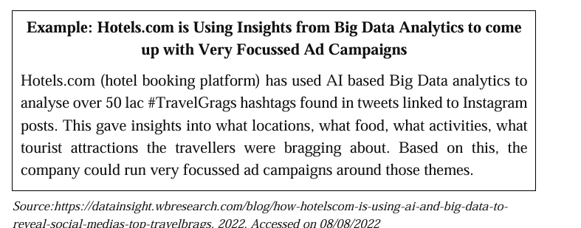
Contd…
Optimization and Marketing-Mixed Modeling (MMM)

